Slide 1
AAM Fitting Algorithm parallel implementation with OpenMP
Based on Efficient Parallel Implementation of Active Appearance Model Fitting Algorithm on GPU
Implementation by: Rafael Rodriguez

Slide 2
Introduction
The Active Appearance Algorithm is a Computer Vision technique that builds a statistical model of an object based on its shape and texture.
The algorithm consists of two separate stages: Training and Fitting.
The goal of the paper, in which this project is based, was to improve the performance of the fitting algorithm as it is the one that would be applied in a real-time setting.

Slide 3
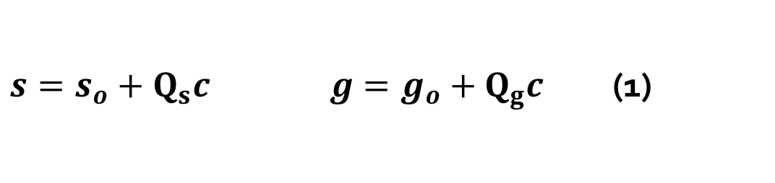
AAM Modeling
Based on a training set of images with labeled landmarks, the algorithms constructs a linear model for both the shape and the texture.
The linear model is based in the PCA technique which produces a set of orthogonal vectors that represent ‘modes of variations’ of the training set and induces a subspace of the original high-dimensional solution space.
As this process is done offline there was not a pressing need to parallelize it.
$s=s_{o}+Q_{s}c g=g_{o}+Q_{g}c$ (1)

Slide 4
AAM Fitting
This algorithm is essentially an unconstraint optimization problem whose objective is to minimize the error between the image’s texture and the one generated by the AAM model.
The sequential algorithm already exploits the characteristics of the problem to efficiently search in the solution space by learning in the modeling phase a linear relationship between the error and the parameter’s deviation from the correct ones.

Slide 5
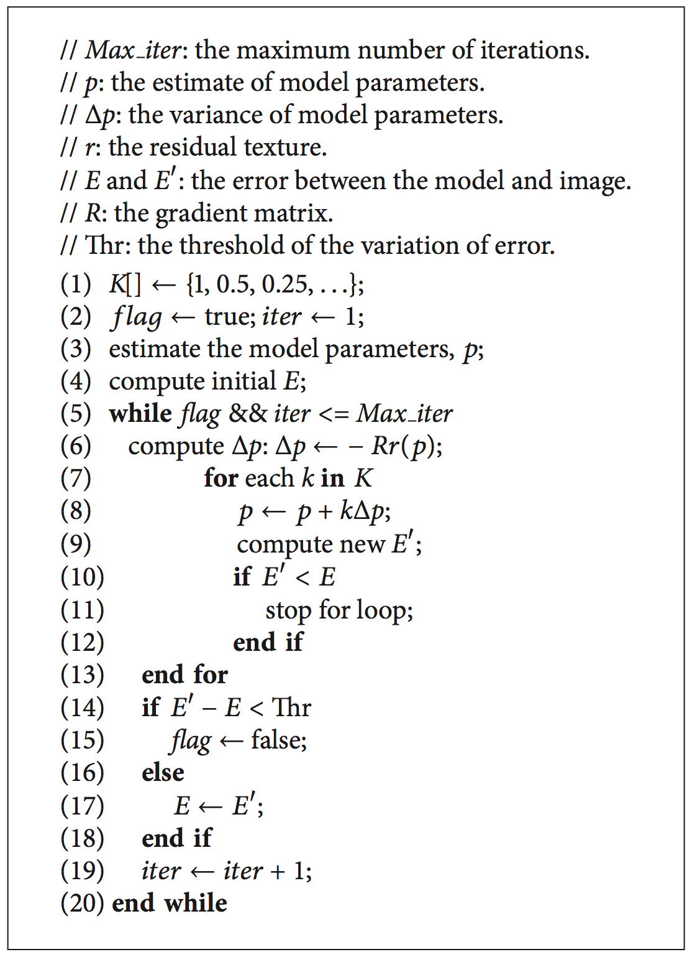
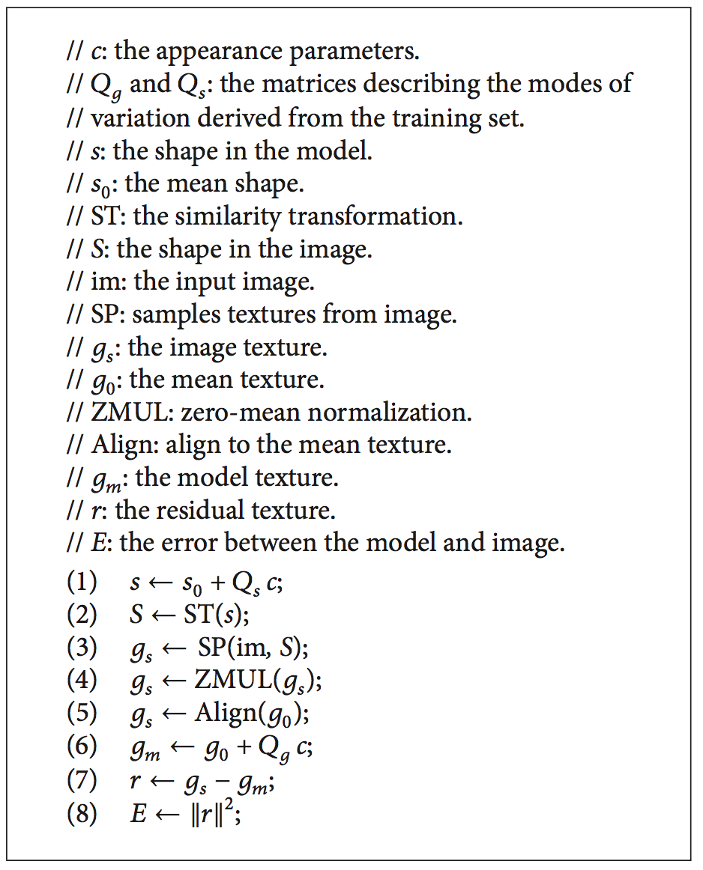
AAM Fitting Sequential Algorithm

Slide 6
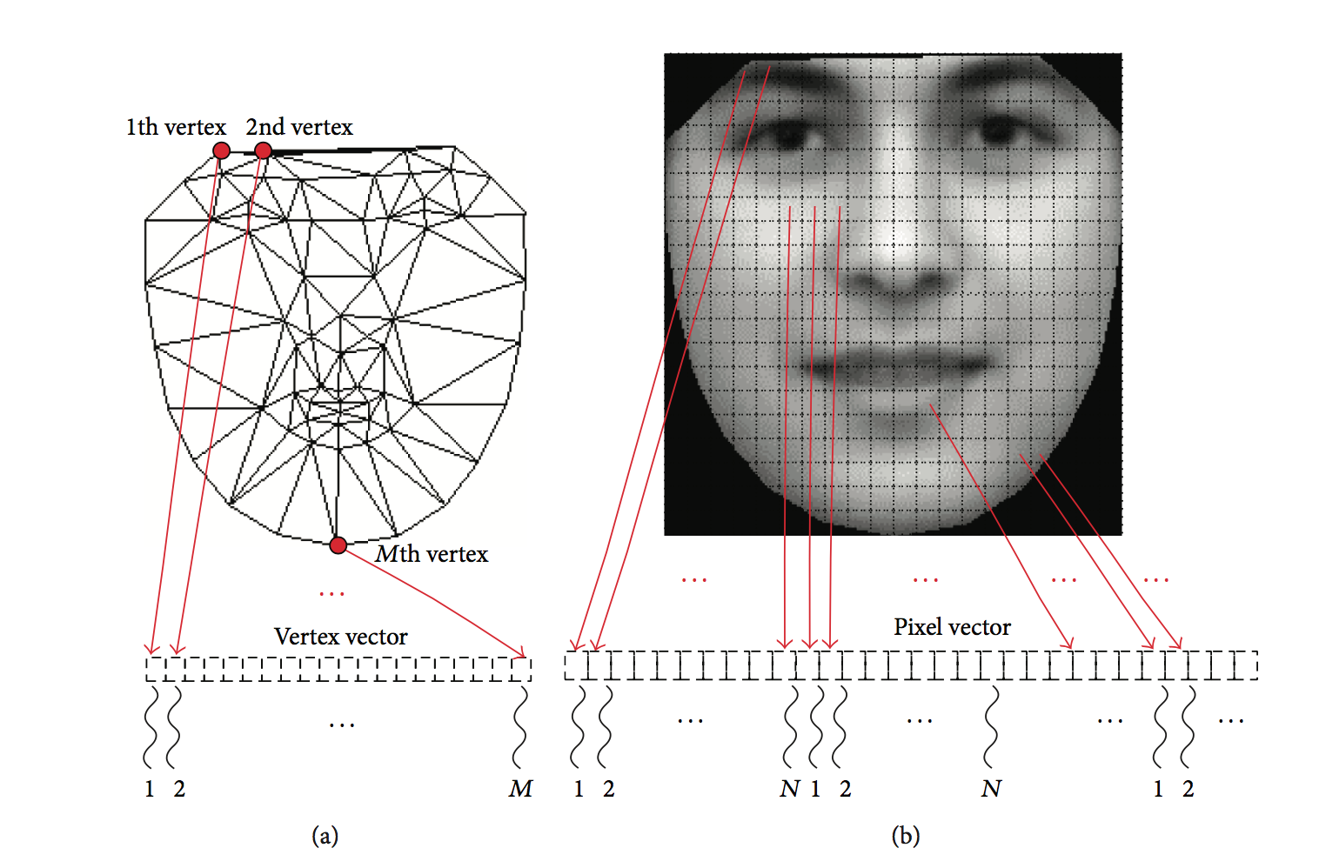
Parallelization idea
Basically, each vertex of the shape and each pixel of the texture is considered to be a separate datum.
As the algorithm was design to be implemented on a GPU, for the shape each vertex is assigned to be process by a thread.
As for the texture, the grid is divided in sets of work to be processed by a thread. Considering that the number of pixels is at least a order of magnitude greater than the number of thread.

Slide 7
Considerations for the OpenMP implementation
The CUDA implementation done by the authors considers the availability of the thousands of threads handled by a GPU.
Using OpenMP with a GPP reduces dramatically the availability threads. Also the memory model is different.
In principle, to implement the parallel tasks in OpenMP both for the shape and texture processing, the data must be broke apart in set of the corresponding unit for processing.

Slide 8
Evaluation (1)
For the training set, it can be used the AAM face dataset provided by the DTU that consists of 240 images of 40 different persons with 58 labeled landmarks.
The authors originally used the FG-Net Dataset but the server is down.
Use an already implemented AAM library or implement the training algorithm from scratch.

Slide 9
Evaluation (2)
For testing the authors used the YouTube face database that have 3425 videos of 1595 different people which is available to perform evaluation of the OpenMP implementation
Compare the speedup obtained with OpenMP and the results obtained by the authors

Slide 10
Implementation
The complete implementation by the authors took 10 CUDA kernels that constitute a pipeline of operations to compute the error in the model fitting.
Parameters’ change estimation
Computing the parameters
Computation of the shape and similarity transformation
Sampling of the image’s texture
Offsetting and Scaling of the image’s sampled texture (4 kernels)
Computation of modelled texture
Difference computation
Error computation

Slide 11
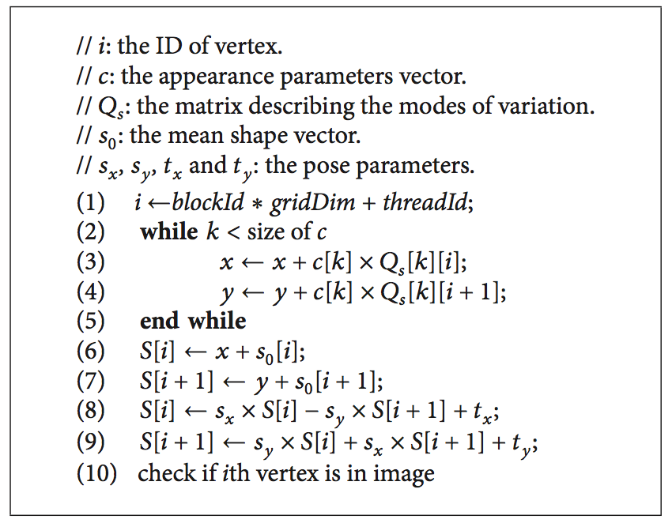
Implementation(2): operation on a to-be-processed unit
This kind of kernel can be easily translated to a omp parallel for construct

Slide 12
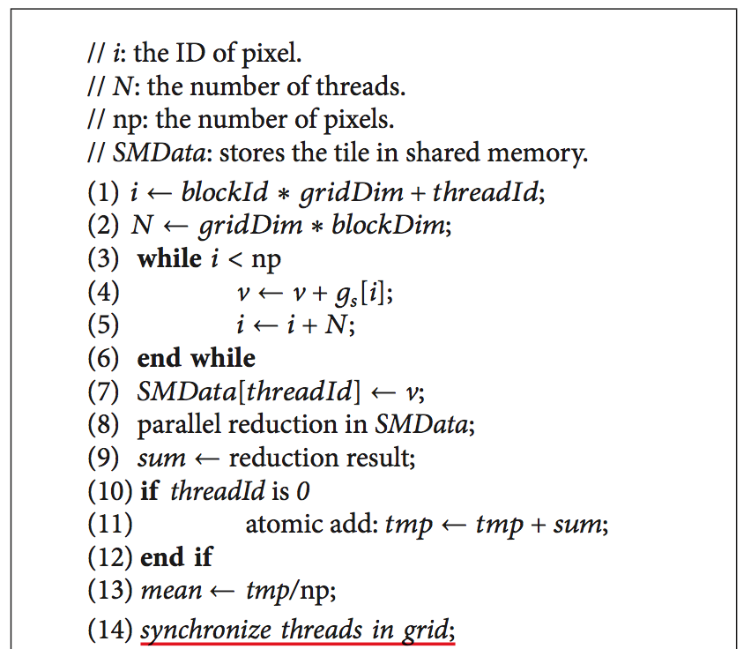
Implementation (3): Aggregation kernels
To compute the normalization of the texture and the squared norm of the texture difference, an openmp reduction variables can be used to translate the reduction done in the CUDA solution done by the authors

Slide 13
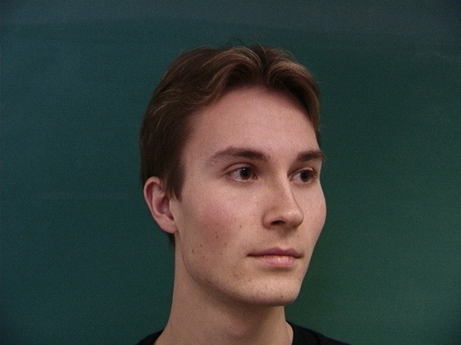
Evaluation (1)
For the evaluation, a procedure similar of that of the authors is followed
A 16-layered model was trained with the annotated images of the IMM Face Database from DTU.
All the images of the database were used to train: 240 images corresponding to 40 different people, 6 poses each.
Each layer of model only changed the number of pixels corresponding to the texture.

Slide 14
Evaluation (2)
For testing, it was used the HELEN Face Database that contains a wide variety of faces ranging from ages of 2 and ~80 years old and people corresponding to different ethnicity.
These images were used to evaluate performance.
To compare the results it was used as a base version the same OpenMP implementation using only 1 thread.
The test were run in a Intel® Core™ i7-4770HQ Processor with 4 cores (8 threads), 2.2Ghz , 6M Cache. The operating system MacOS Sierra.
This processor also supports SSE4.1/4.2 and AVX 2.0 extensions

Slide 15
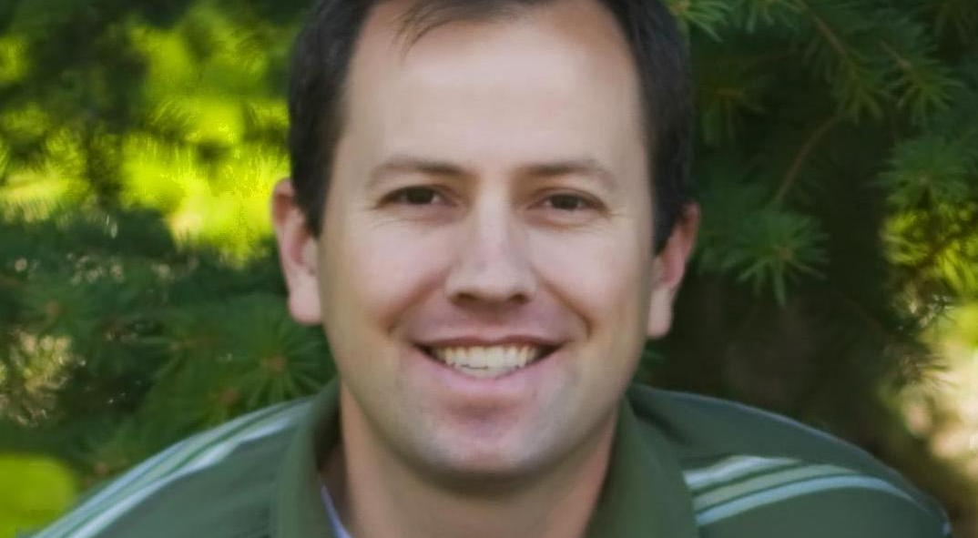

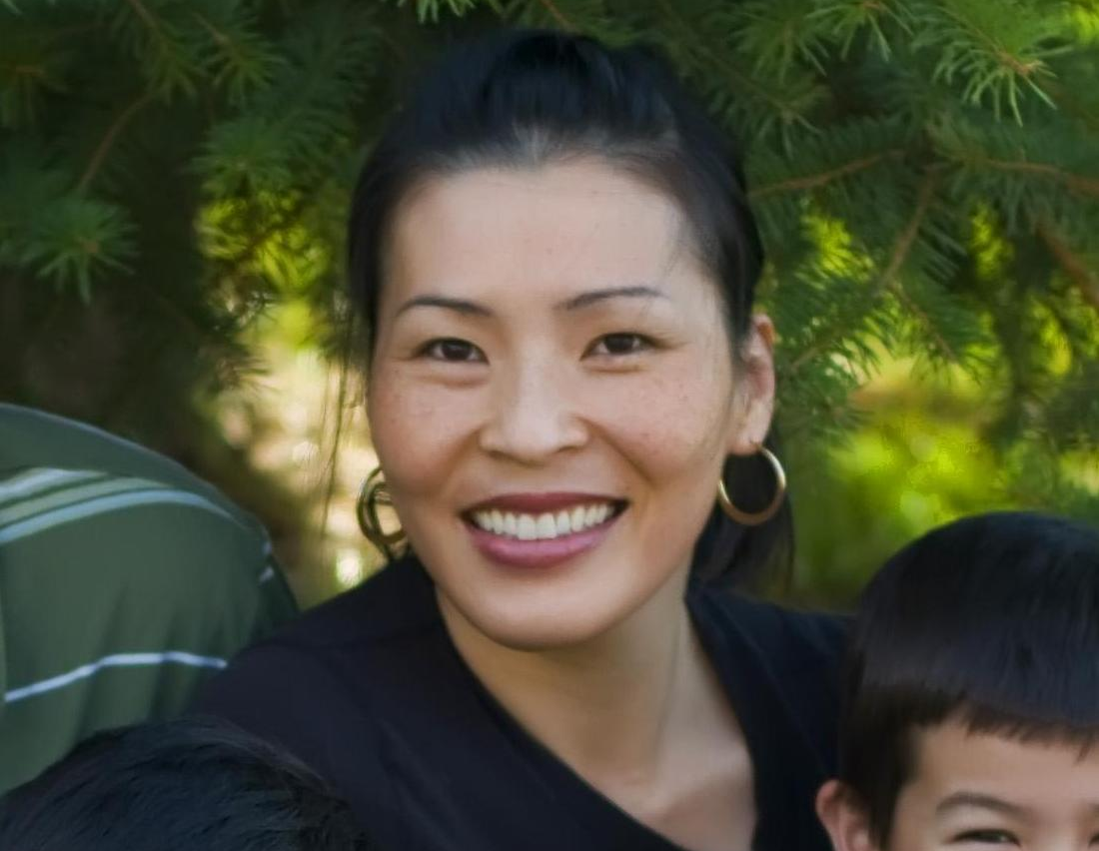

Evaluation (3)
The parallel and serial versions were run for 50, 100, 150,…, 300 frames. 3 times each run so the results were averaged to reduce the effect of the OS.

Slide 16
Evaluation (4)
Here can be seen that the trend is linear with the number of frames as the amount of frames does not affect the time taken to make a fitting iteration
It can be noted that a reduction in the number of pixels make the lines to be more similar, meaning that the speedup is reduced considerably.

Slide 17
Evaluation (5)
Here it can be seen that the speedup has a non linear behavior. As expected from the previous plots, reducing the amount of pixels in model make the cost to parallelize way higher than the sequential algorithm and makes the speedup tend to zero.

Slide 18
SIMD instructions
This Speedup SIMD was done comparing the average time per iteration of the single thread version with that obtained using SIMD OpenMP construct and a single thread

Slide 19
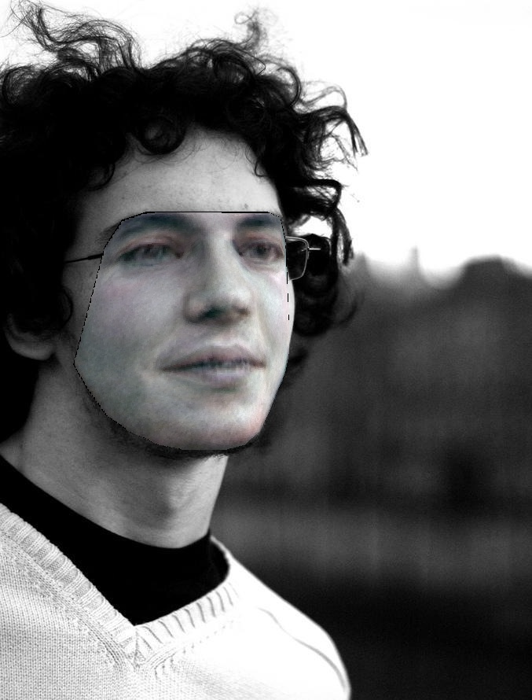
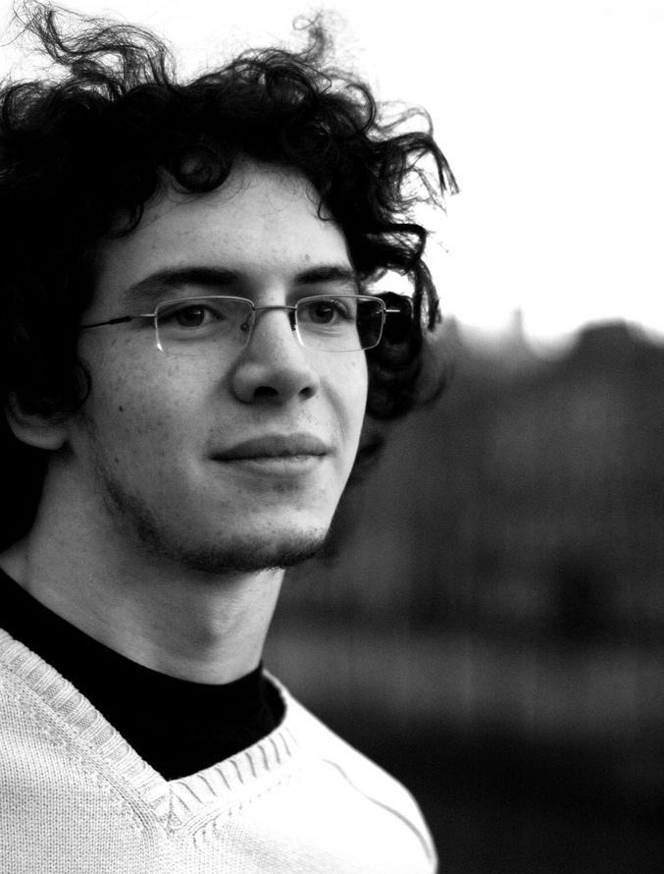
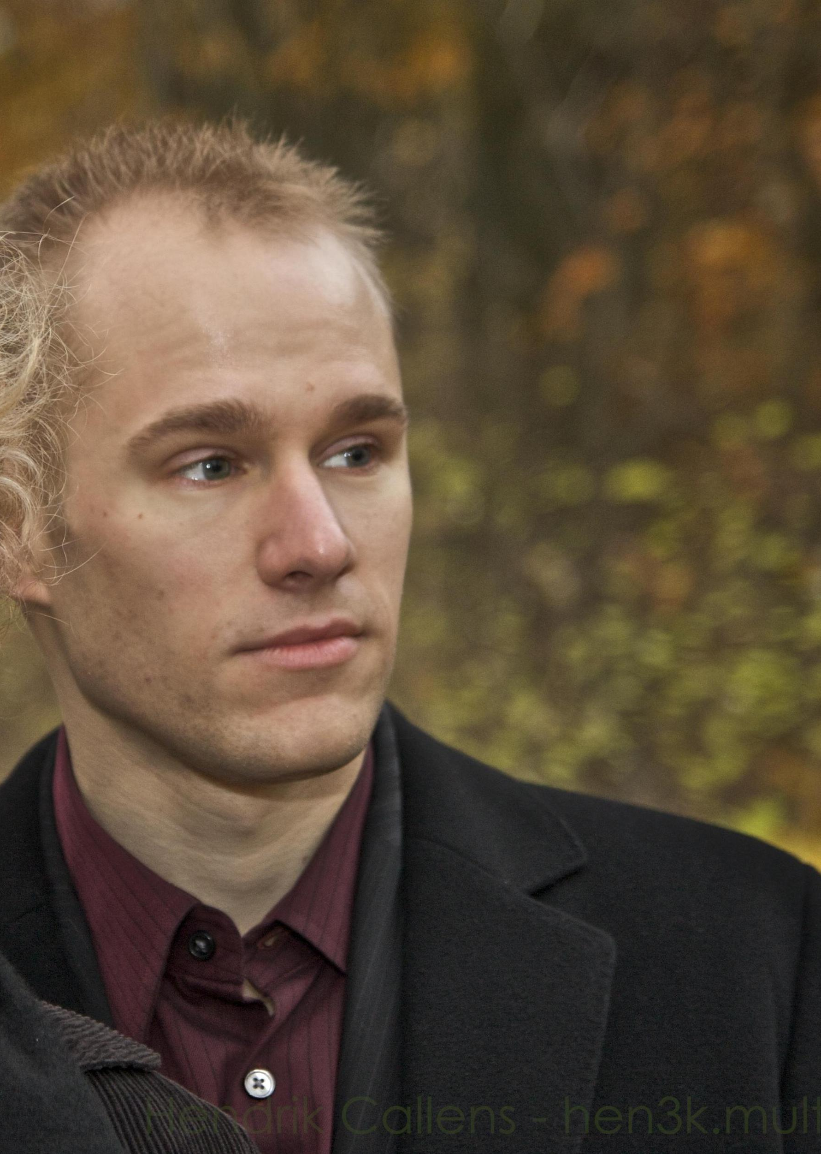
Final Remarks
The implementation done with OpenMP exhibits similar behavior to that implemented by the authors in the paper. Being the principal difference the amount of threads a GPU can handle in contrast with that of a CPU.
During the implementation the parallel algorithm in OpenMP, some tweaks to the scheduling of the parallelized for loops should be done to achieve good results. However, even changing the chunk size of the scheduling didn’t make much improvement to the parallel algorithm for small models.

Slide 20
Thanks!
Cmake Project: https://github.com/rafarodsa/AAMParallelFitting

